Slide 1
Chapter No:7
Latches and Flip Flop

Slide 2
TOPICS
1. Latches
2. Flip-Flops
3. Flip-Flop Operating Characteristics
4. Flip-Flop Applications

Slide 3
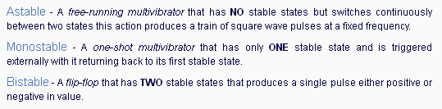
Flip-Flops
. The fundamentals of sequential logic , Bistable, Monostable, and Astable logic devices called multivibrators . A multivibrator circuit oscillates between a "HIGH" state and a "LOW" state producing a continuous output.
Two categories of bistable devices are the latch and the flip-flop. The flip-flop is a basic building block for counters, registers, and other sequential control logic and is used in certain types of memories

Slide 4

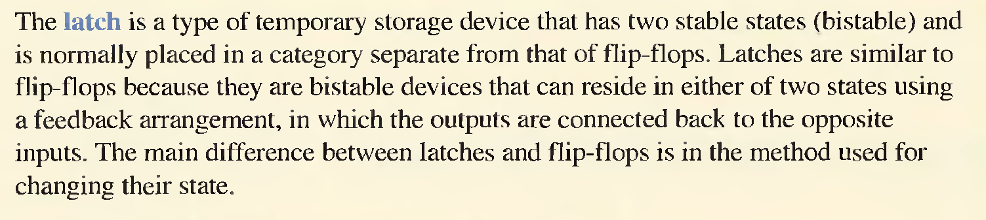

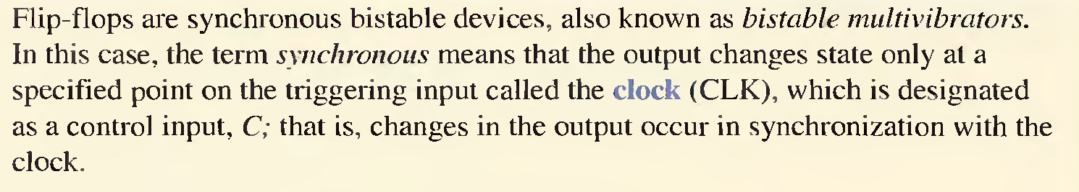

Slide 5

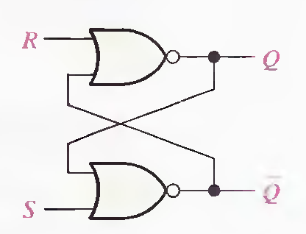
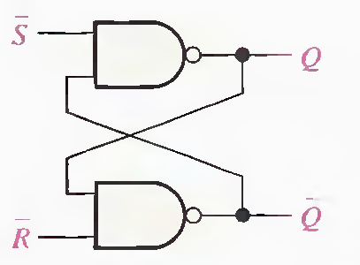


A latch is a type of bistable logic device or multivibrator. An active-HIGH input S-R (SET- RESET) latch is formed with two cross-coupled NOR gates, an active-LOW input S-R latch is formed with two cross-coupled NAND gates, .That the output of each gate is connected to an input of the opposite gate .This produces the regenerative feedback that is characteristic of all latches and flip-flops.

Slide 6
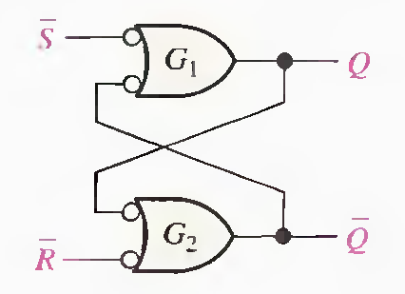
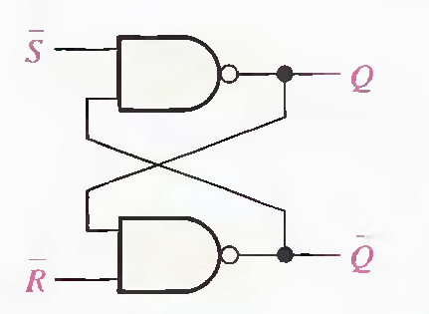
Let's start by assuming that both inputs and the Q output are HIGH. Since the Q output is connected back to an input of gate G2, and the R’ input is HIGH, the output of G 2 must be LOW. This LOW output is coupled back to an input of gate G1 to ensuring that its output is HIGH.
When the Q output is HIGH, the latch is in the SET state. It will remain in this state in-
definitely until LOW is temporarily applied to the R’ input.
With a LOW on the R’ input and a HIGH on S’, the output of gate G 2 is forced HIGH. This HIGH on the Q’ output is coupled back to an input of G 1 , and since the S’ input is HIGH, the output of G 1 goes LOW. This LOW on the Q output is then coupled back to an input of G 2 , ensuring that the Q’ output remains HIGH even when the LOW on the R’ input is removed.
When the Q output is LOW, the latch is in the RESET state. Now the latch remains indefinitely in the RESET state until a LOW is applied to the S’ input.

Slide 7


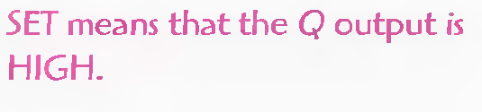
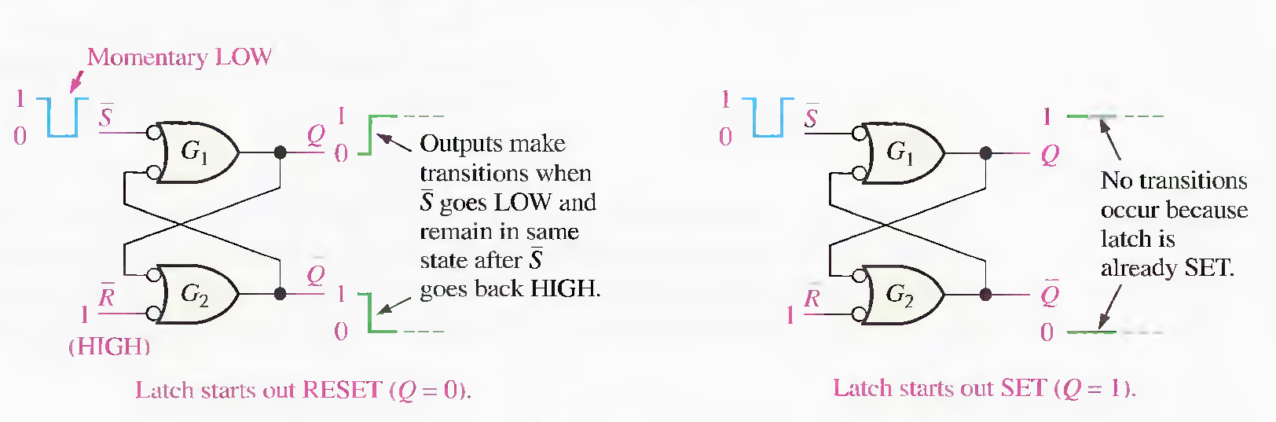
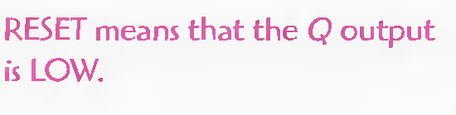
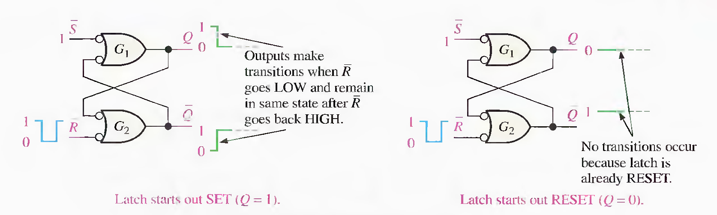

Slide 8


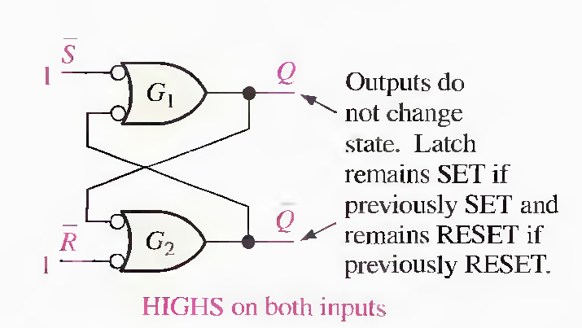
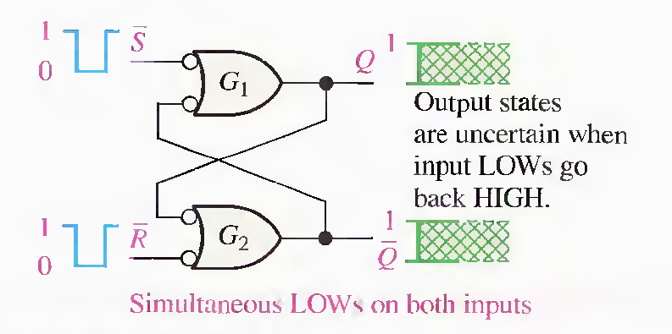
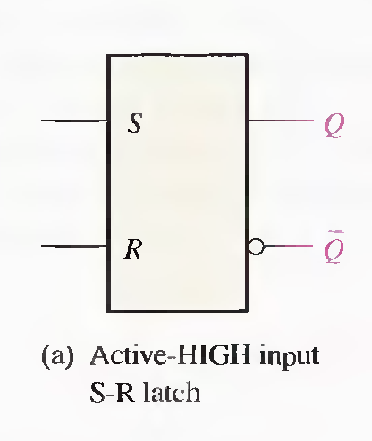
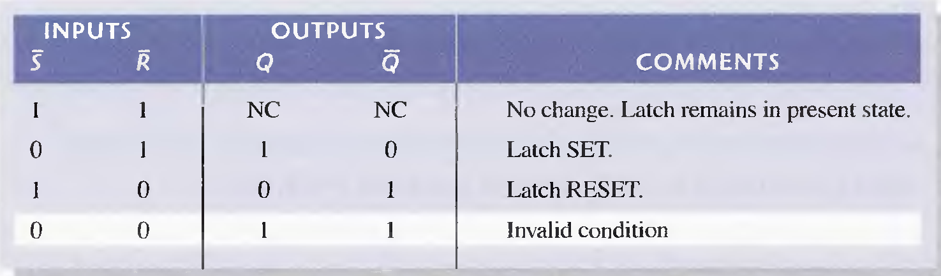

Slide 9
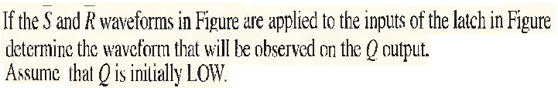
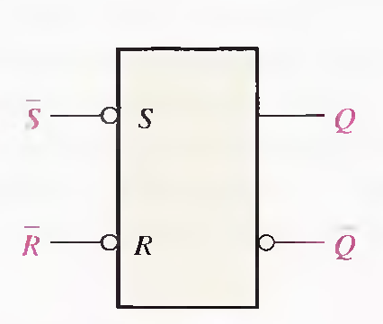
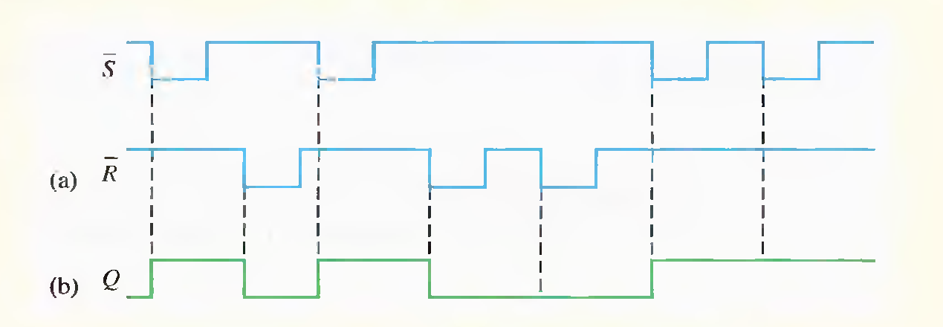

Slide 10

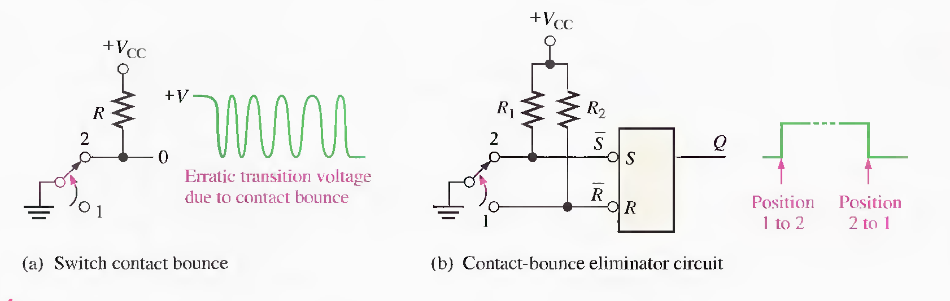

Slide 11

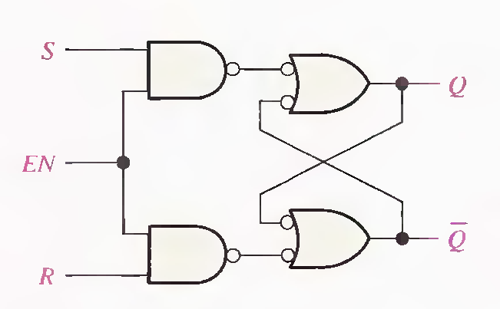
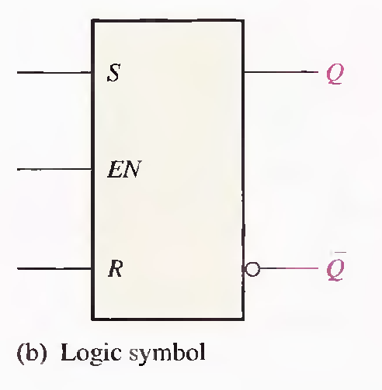
A gated latch requires an enable input. EN (G is also used to designate an enable input). The S and R inputs control the state to which the latch will go when a HIGH level is applied to the EN input. The latch will not change until EN is HIGH; but as long as it remains HIGH, the output is controlled by the state of the S and R inputs. In this circuit, the invalid state occurs when both Sand R are simultaneously HIGH.

Slide 12


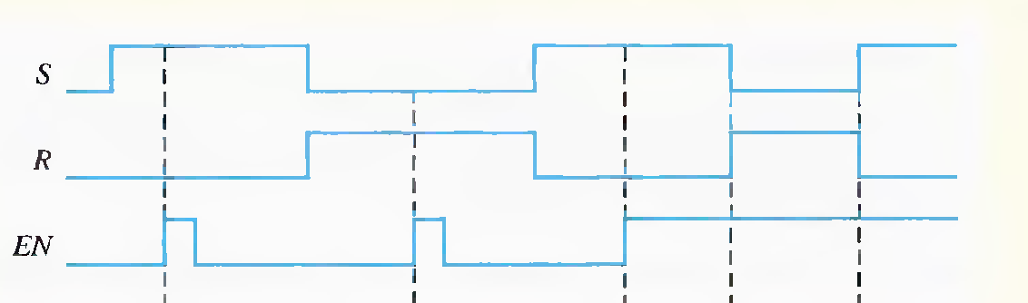
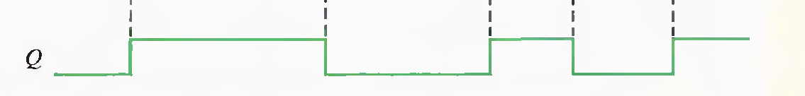

Slide 13

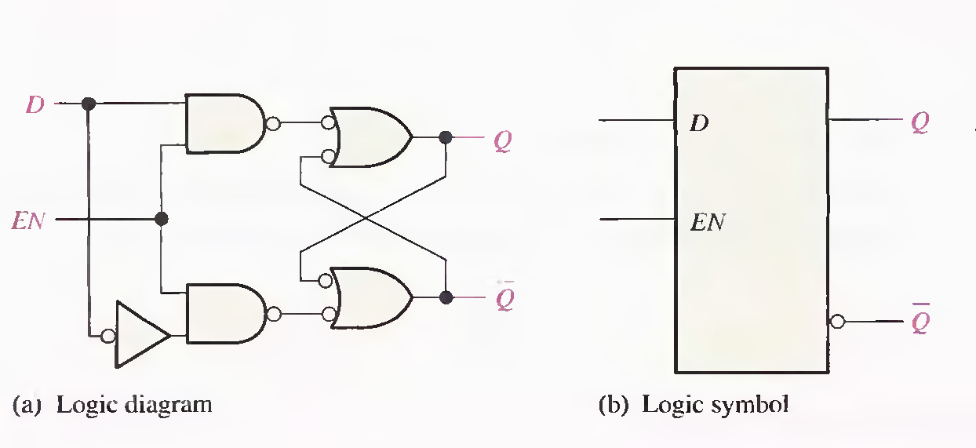
Gated D latch is differs from the S-R latch because it has only one input in addition to EN. This input is called the D (data) input. When the D input is HIGH and the EN input is HIGH, the latch will set. When the D input is LOW and EN is HIGH, the latch will reset. Stated another way, the output Q follows the input D when EN is HIGH.

Slide 14
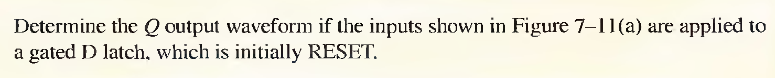
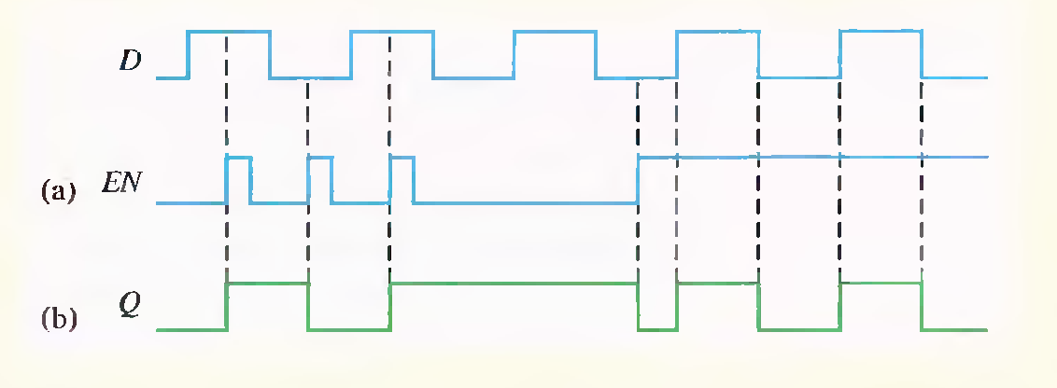

Slide 15


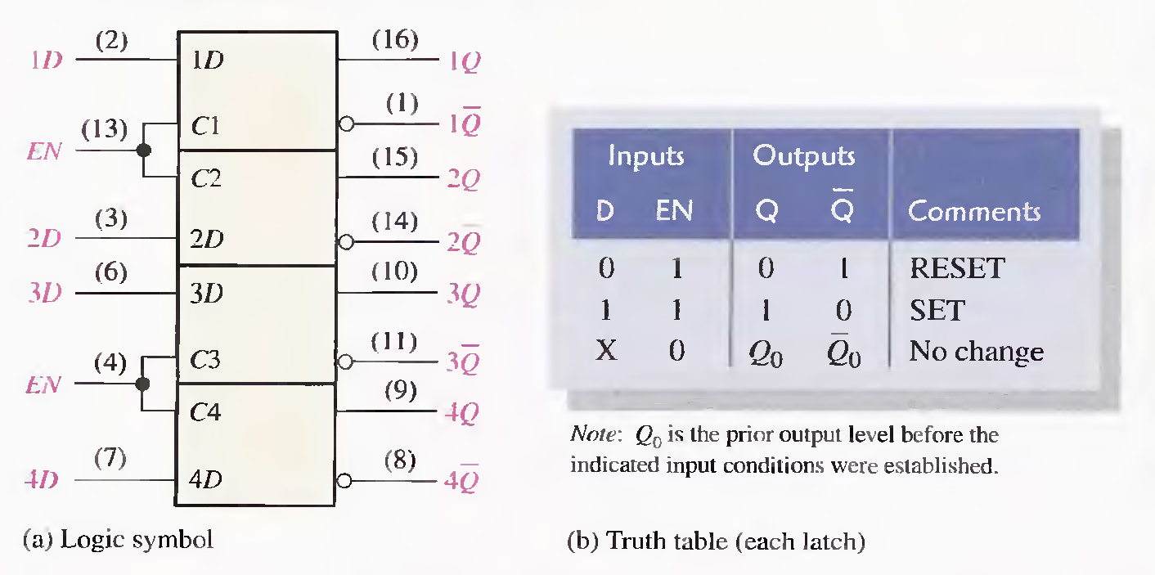

Slide 16
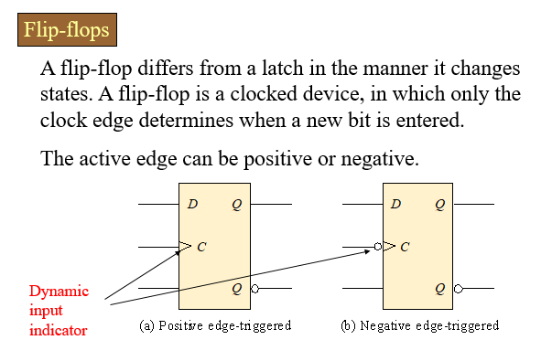

Slide 17
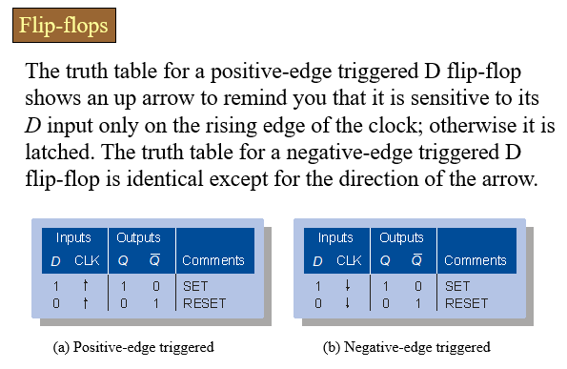

Slide 18

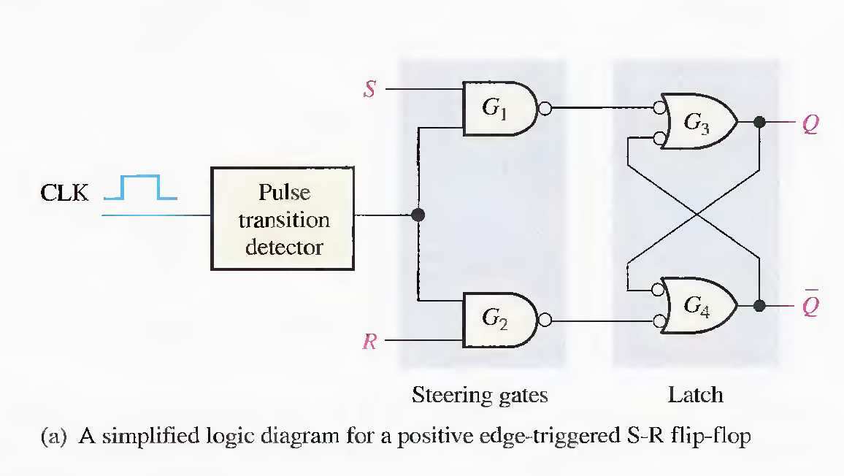
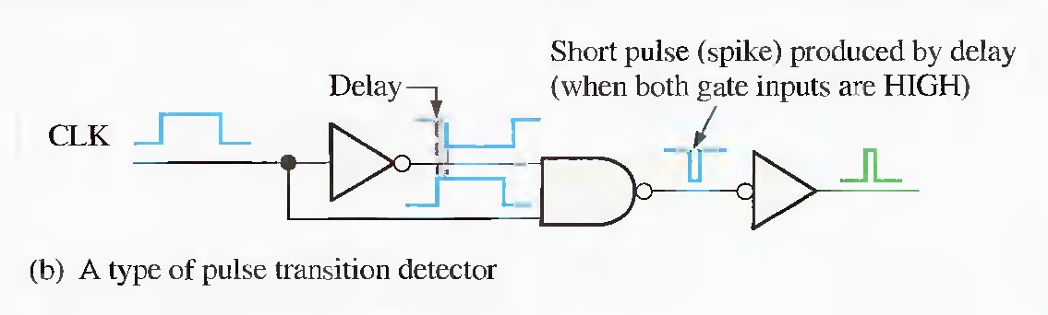

Slide 19

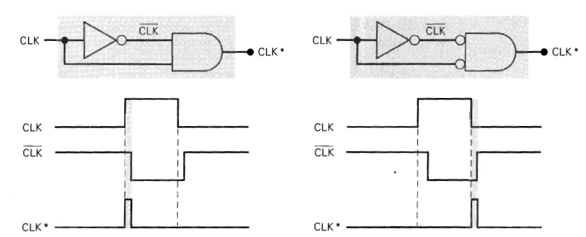
A type of Pulse Transition detector

Slide 20
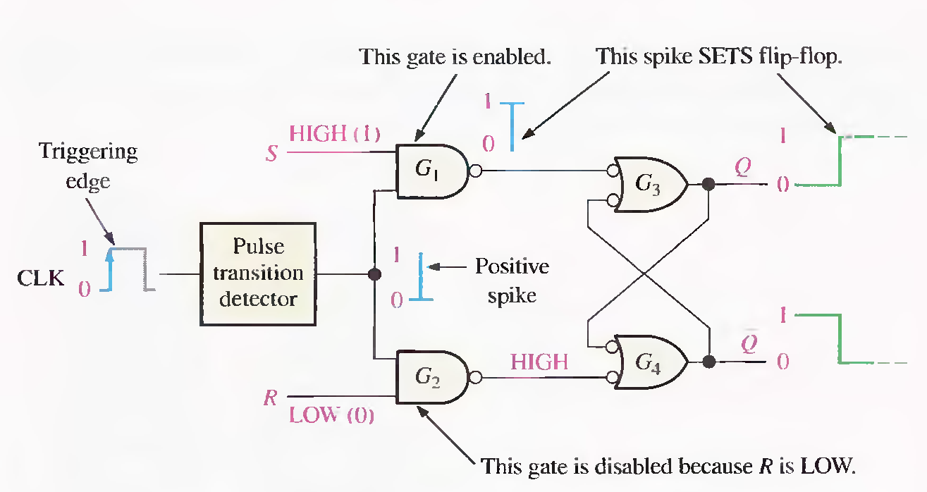
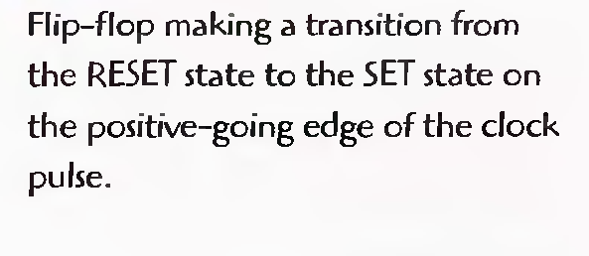
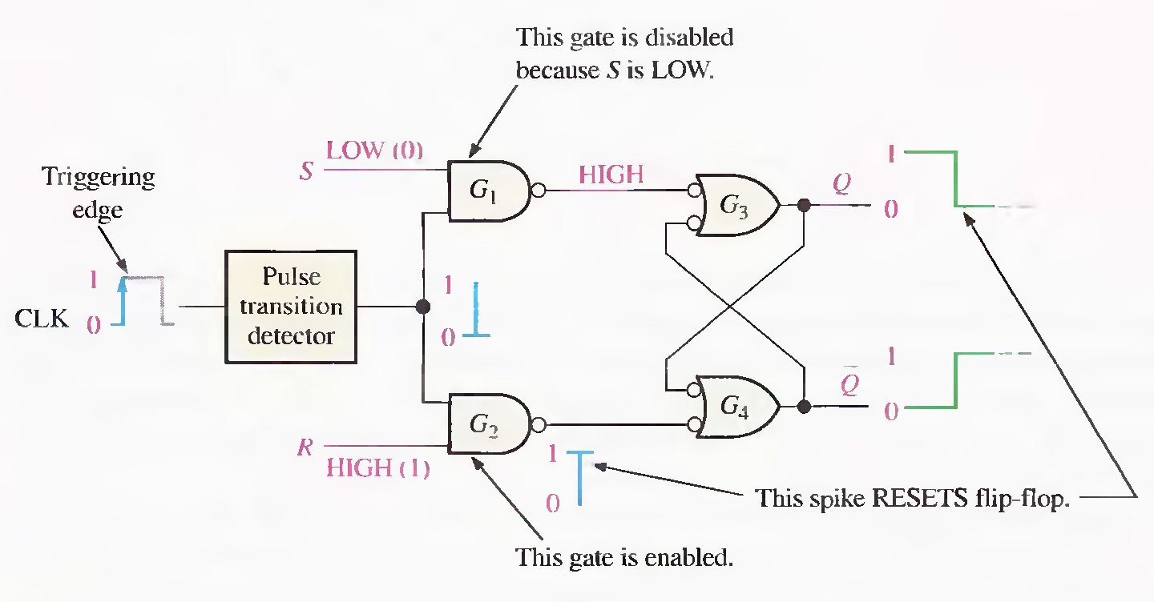
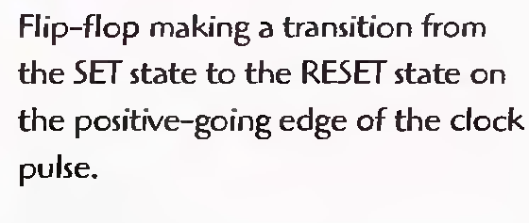

Slide 21

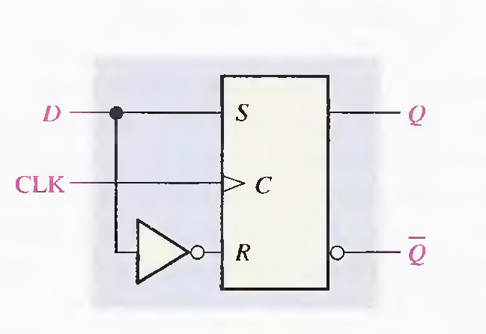
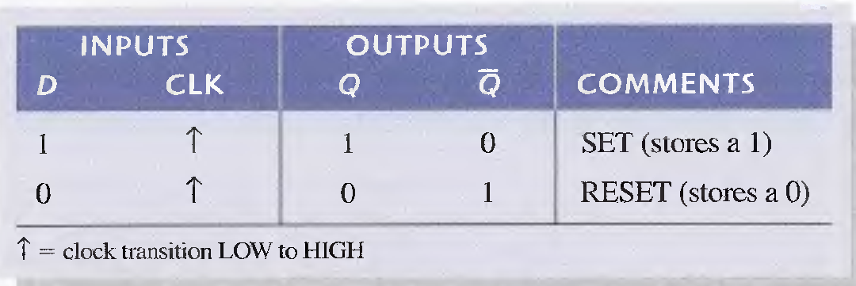
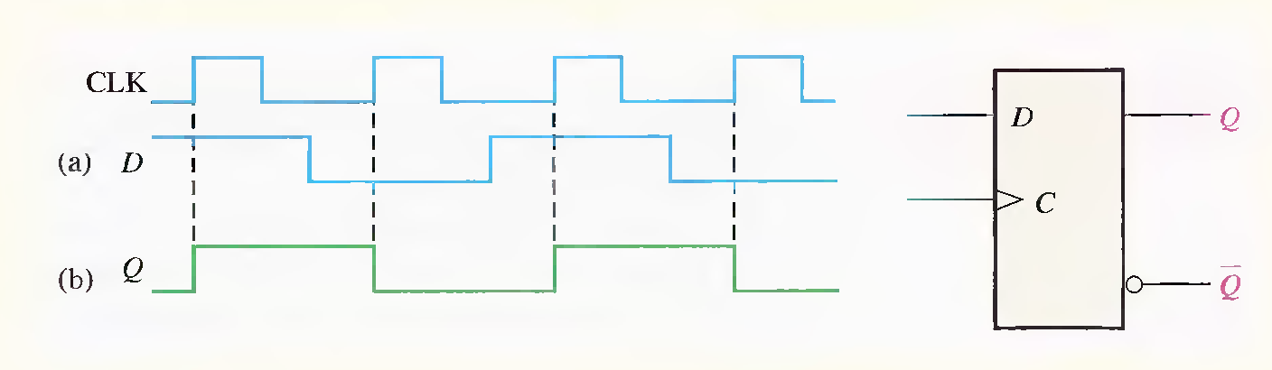

Slide 22

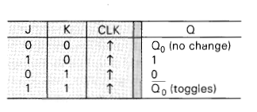
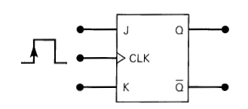
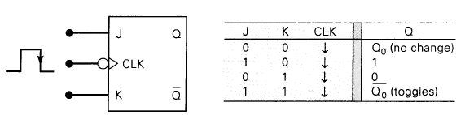
The J and K inputs control the state of the FF in the same ways as the S and C input do for the clocked S-C Flip Flop except one major difference:
The J=K=1 condition does not result in an ambiguous output.
For this condition J=K=1, the FF will always go to its opposite state upon the positive transition of the clock signal. This is called the
Toggle Mode of operation.

Slide 23
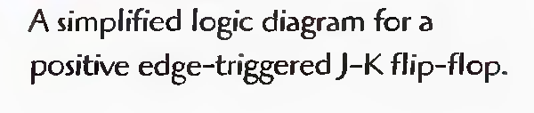
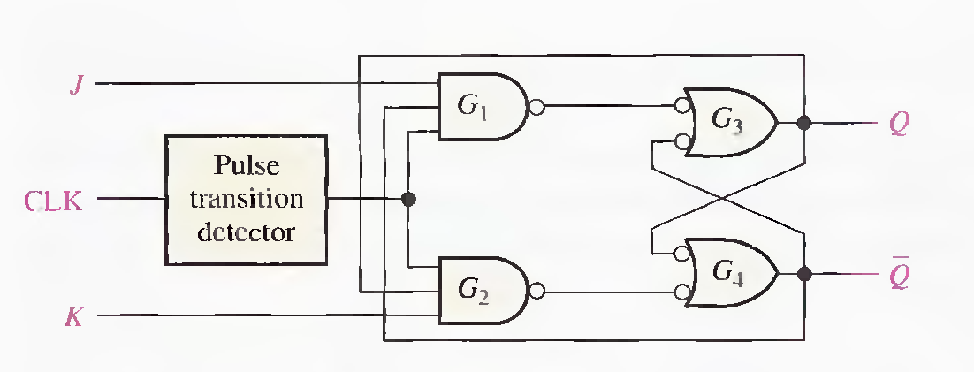
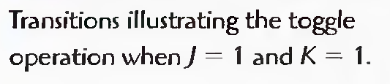
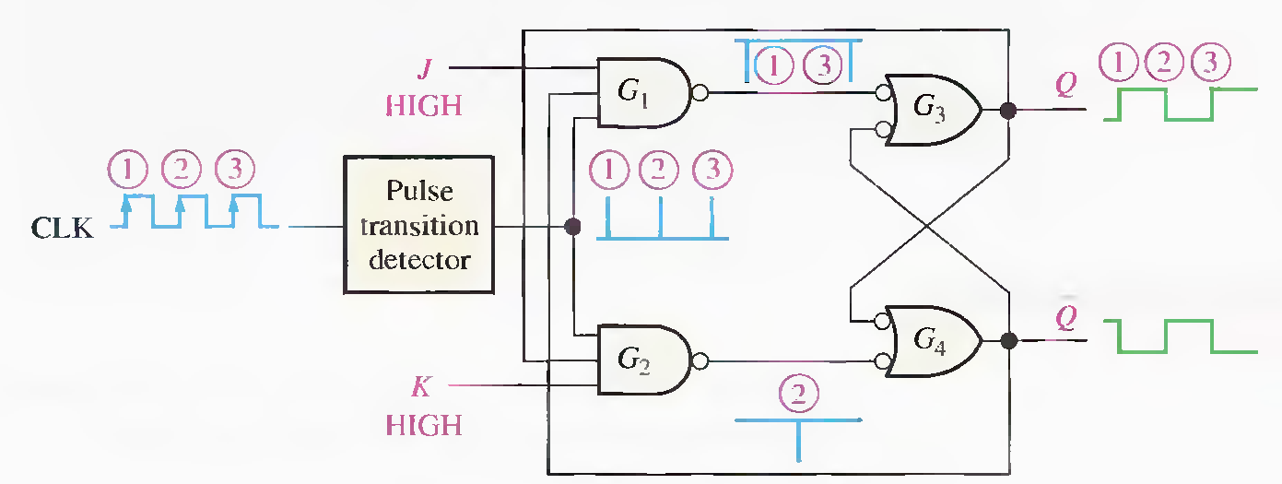

Slide 24

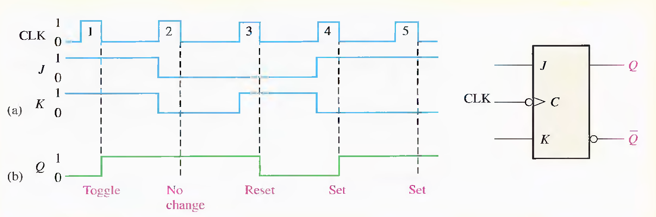

Slide 25
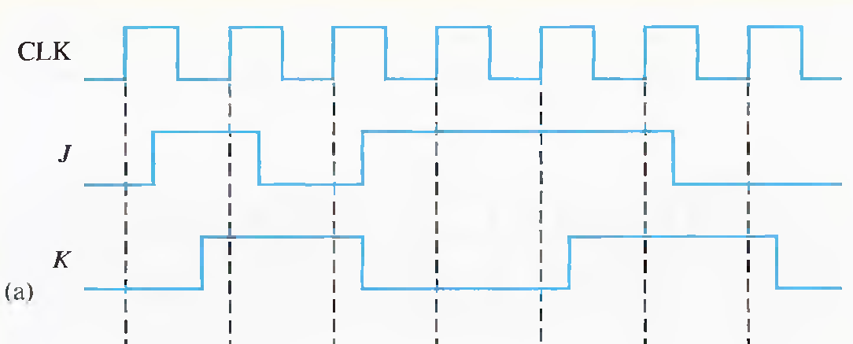
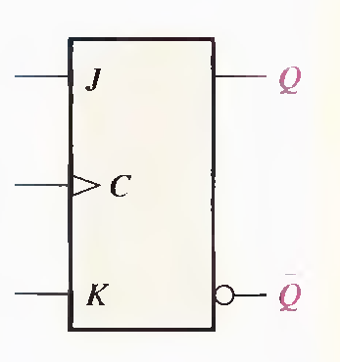
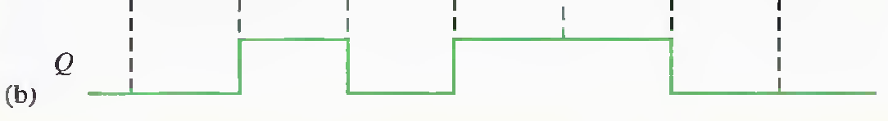

Slide 26


Slide 27


Slide 28





Slide 29




The set-up time (ts) is the minimum interval required for the logic levels to be maintained constantly on the inputs (J and K, or Sand R, or D) prior to the triggering edge of the clock pulse in order for the levels to be reliably clocked into the flip-flop.
for a D flip-flop.
The hold time (th) is the minimum interval required for the logic levels to remain on the inputs after the triggering edge of the clock pulse in order for the levels to be reliably clocked into the flip-flop.
for a D flip-flop.

Slide 30







Slide 31



Slide 32




Slide 33






Slide 34




Slide 35




Slide 36



Slide 37



Slide 38


Slide 39


Slide 40


Slide 41






Slide 42




